Slide 1


Storing memory in chemical reaction systems
Sahil Moza
CAMP - 2016

Slide 2
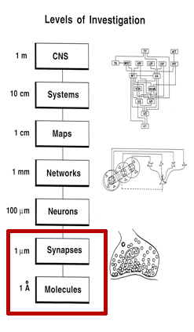
Multi-scale models try to explain different scales of length and time.

Slide 3
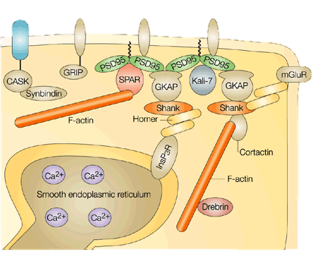
Biochemistry of micro-domain
NMDA
AMPA
Structural: Actin interacting proteins.
Signaling : Canonical LTP pathway, CaMKII, PKA, Receptor cycling
Scaffolding proteins: Large Post-Synaptic-Density
Biochemical isolation from dendrite.
Existing bistable motifs (Hayer et al, 2005)
Spinal morphology and biochemistry (Herring et al.)
Notes:
This slide is vague…

Slide 4
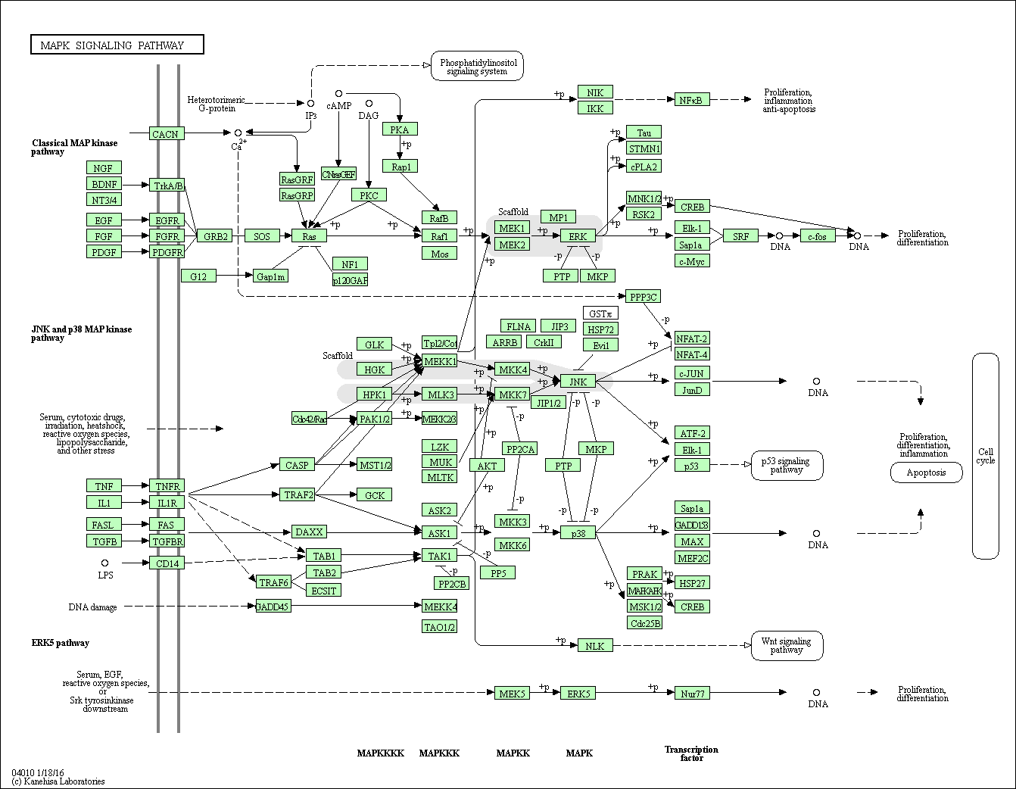
Storing memory in biochemistry

Slide 5
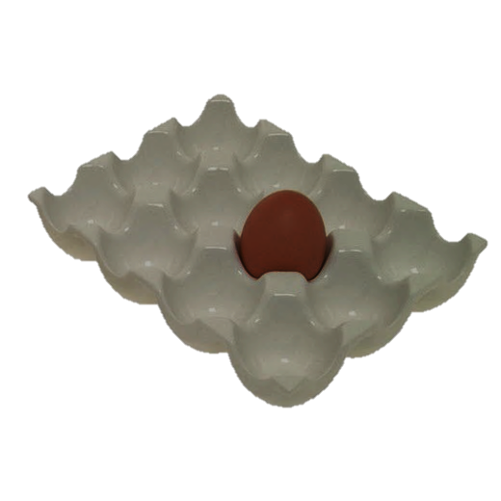
How can memory be stored in biochemistry?
Multiple steady states => multi-stable dynamics => Multiple energy minima.
Bistable systems: 2 steady states of concentrations of reactants and products.
V
X
Dynamical Systems :
2 Stable fixed points

Slide 6
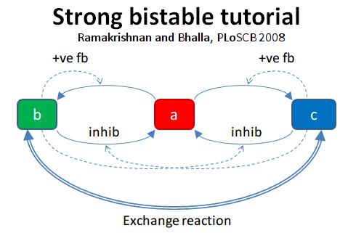
How to build a bistable system?
Positive feedback loops
Tune the parameters.
Check for stable states.
Let’s try finding steady states of a bistable system in moose!

Slide 7
Assumptions and models
Assumes existence of stable states,
Ignores dynamics
Steady States
Detail

Slide 8
Assumptions and models
Assumes existence of stable states,
Ignores dynamics
Steady States
Deterministic simulation
Space is assumed to be infinite.
Time evolution of chemical reaction equations
Detail

Slide 9
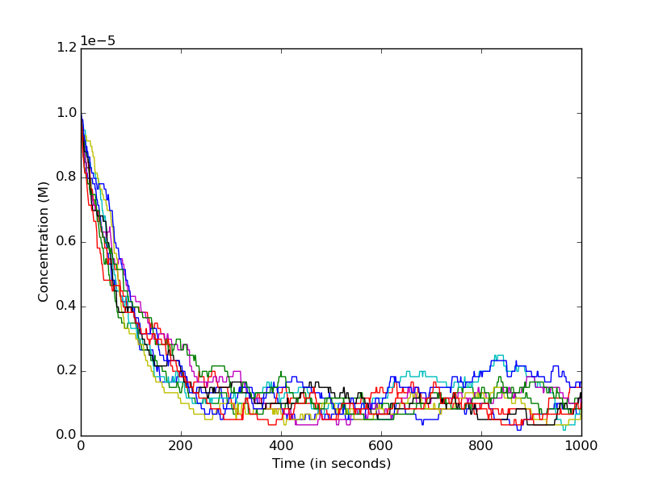
Stochasticity affects behaviour of bistable systems
V
ε↑
X
Noise can lead to state transitions.

Slide 10
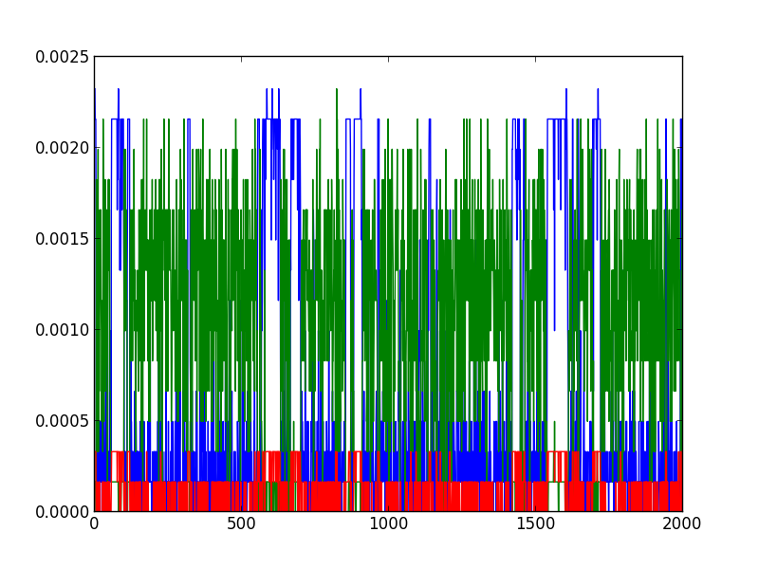
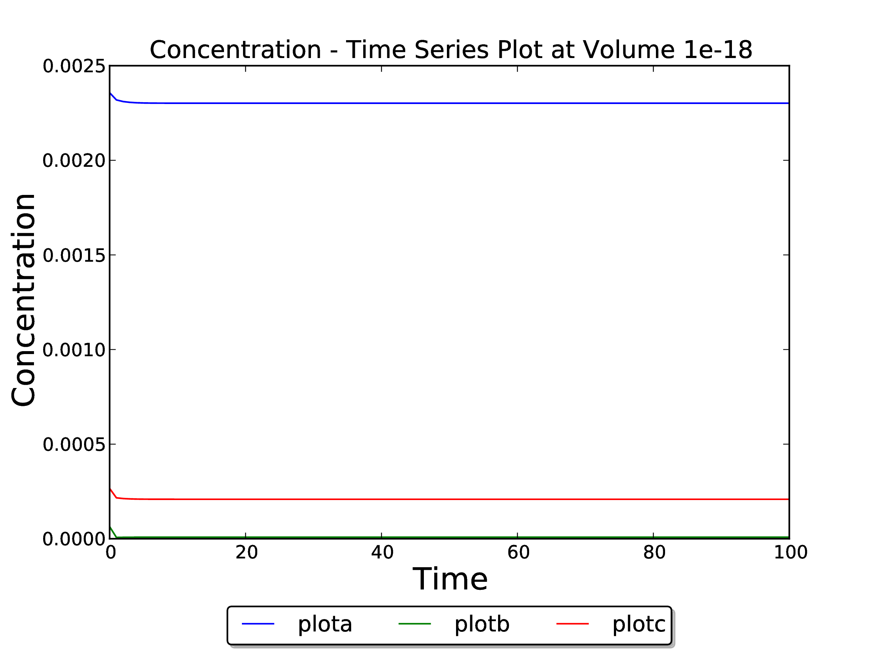
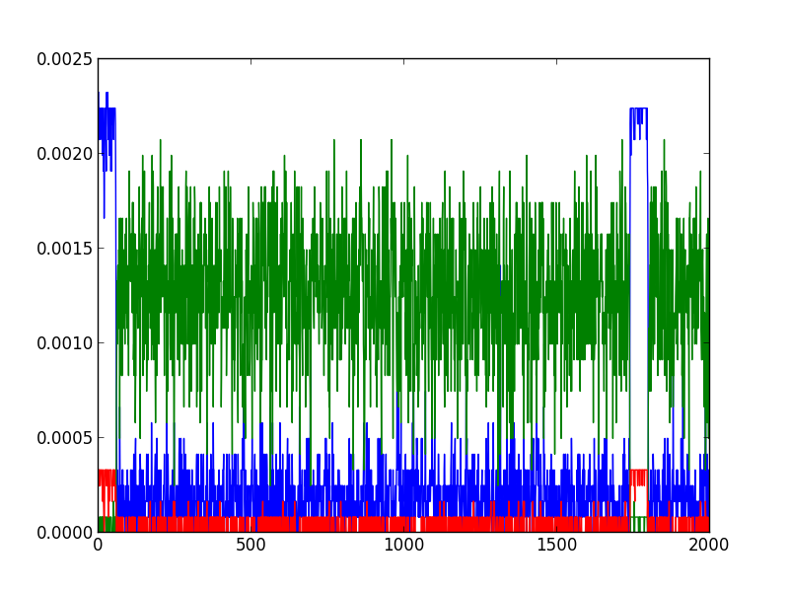
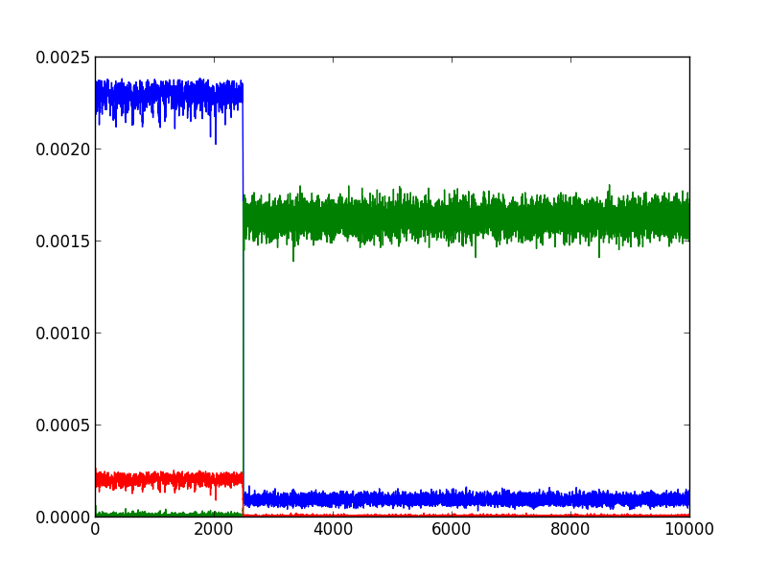

Frequency of state transitions decreases with increasing volumes
a
b
c
1e⁻²⁰ m³
1e⁻¹⁹ m³
1e⁻¹⁸ m³
Concentration
Deterministic Simulation ≈ Infinite volume
0
1
Time (2000s)
Time (2000s)
Time (10000s)
Noise
Volume

Slide 11
Assumptions and models
Assumes existence of stable states,
Ignores dynamics
Finite space, and number of reacting particles
Steady States
Deterministic simulation
Stochastic Simulation
Space is assumed to be infinite.
Time evolution of chemical reaction equations
Detail

Slide 12
Assumptions and models
Assumes existence of stable states,
Ignores dynamics
Finite space, and number of reacting particles
Steady States
Deterministic simulation
Stochastic Simulation
Diffusion modeling
Space is assumed to be infinite.
Time evolution of chemical reaction equations
Can have spatial properties.
Assumes well-mixed chemistry.
Detail

Slide 13
Assumptions and models
Assumes existence of stable states,
Ignores dynamics
Finite space, and number of reacting particles
Track position and velocity of diffusing particles in time.
Steady States
Deterministic simulation
Stochastic Simulation
`
Diffusion modeling
Microphysiological
Space is assumed to be infinite.
Time evolution of chemical reaction equations
Time evolution of the diffusion equation.
Can have spatial properties.
Assumes well-mixed chemistry.
Detail

Slide 15
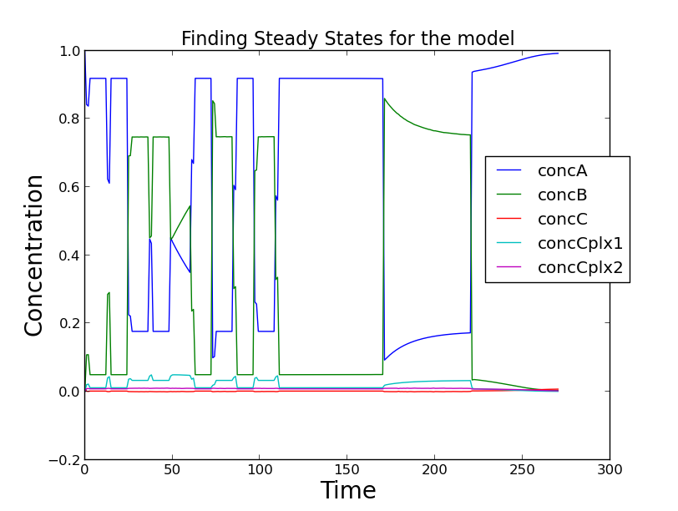
Steady State Finding
MOOSE does a systematic sweep by making random jumps in the initial condition space of models.
The initial conditions chosen are constrained by Stoichiometry, and are allowed to settle to the nearest stable state.
This is corroborated by checking eigenvalues of Jacobian at the steady state, and classifying state as stable, unstable, saddle, oscillatory, or others.
The steady states found are then classified, by uniqueness, using some measure of distance.

Slide 16
Numerical Methods used
GSL (GNU Scientific Library) for Deterministic simulation and Steady State Evaluation.
Random number generation: Mersenne Twister pseudo-random number generator.
Deterministic Simulation: Adaptive time-step 5th order Runge-Kutta-Fehlberg method (rk5).
Stochastic simulation : Gillespie Stochastic Simulation Algorithm (first reaction method) (Gillespie, 1977)
Simulation environments: Multi-scale Object Oriented Simulation Environment (MOOSE)

